Slide 1
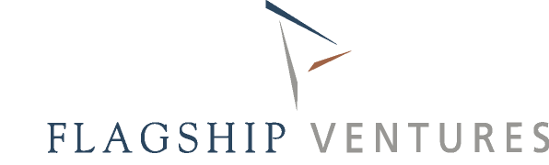
Financing Entrepreneurial Innovation
Getting Clean Tech
Innovation to Market
C2M Class Discussion
Thursday, January 21, 2010

Slide 2

First, A Quick Survey…

Slide 3
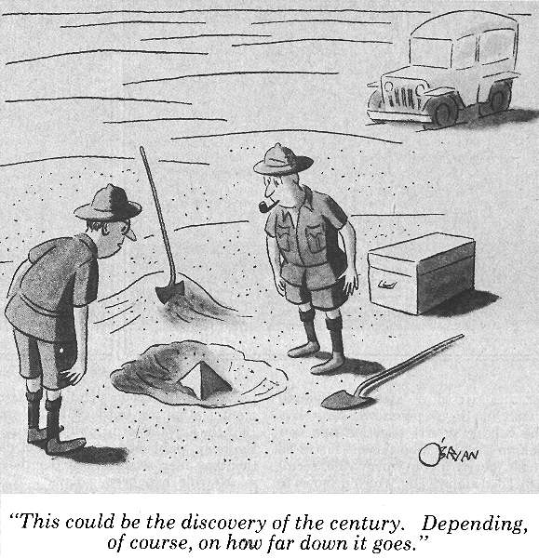
Mission: Finding The Big Idea

Slide 4
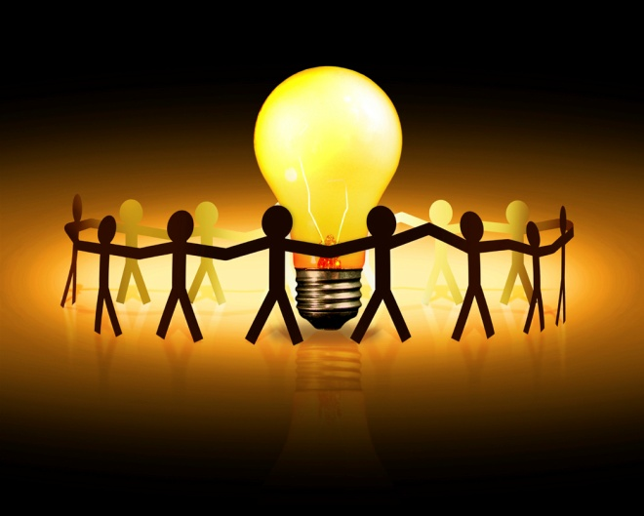
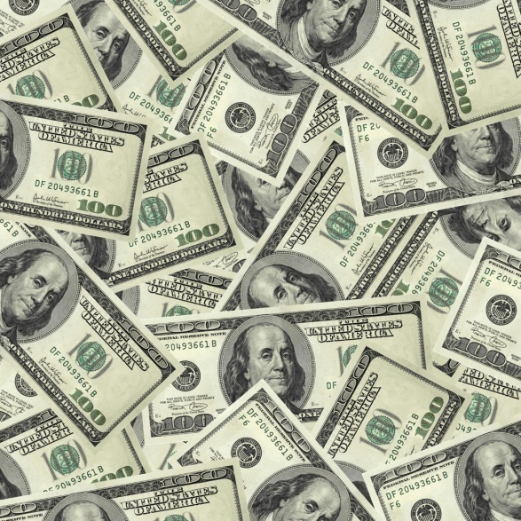
It’s Simple, Right?
1. Come Up With A Killer Idea….
2. Recruit (Zealotous) Team to Build “It”…
3. Take “It” to the bank!

Slide 5
A Few Questions About “It”
What problem will “It” solve?
What kind of people will buy “It”?
How many people will buy “It”?
Who will sell “It”?
How much will people pay for “It”?
How much will “It” cost to make?
Who else makes something like “It”?
Where will you get the money to make “It”?

Slide 6
What’s The Right Approach?
Market Down
Technology
Up

Slide 7
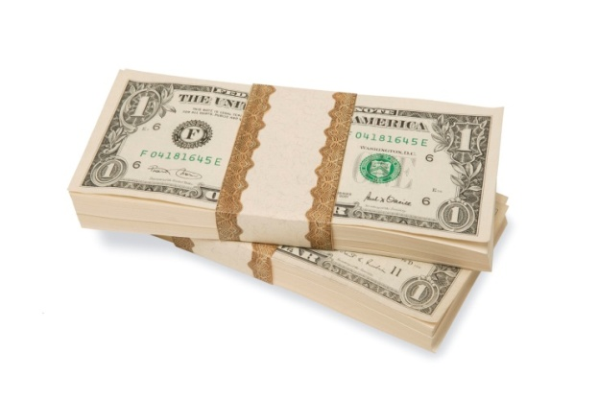
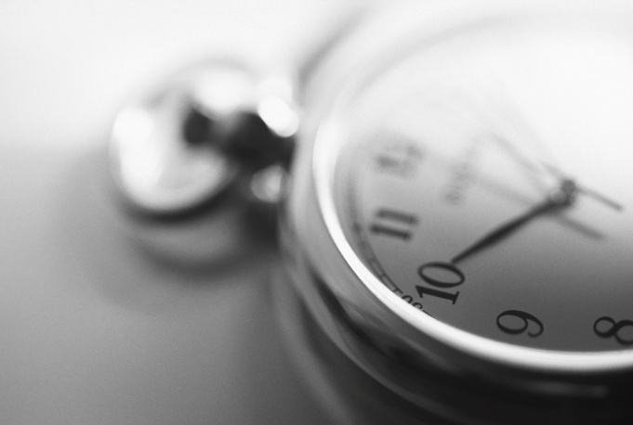
Both…Actually, All Three!
Product
Market

Slide 8
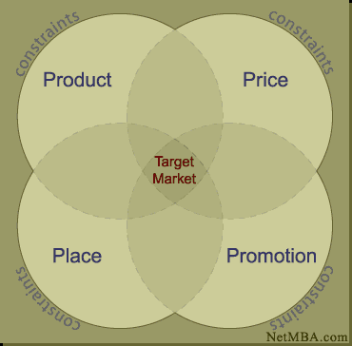
What? That Old Framework…

Slide 9
Opportunity Recognition
Discovery /
Insight
Unmet
Need
Value
creation
strategy
Value
hypothesis

Slide 10
Platform vs. Product
Product / Market Segment #1
#2-3
#4-n

Slide 11

Focusing on the “One Thing”

Slide 12
Who’s Your Target Market? First Market?

Slide 13
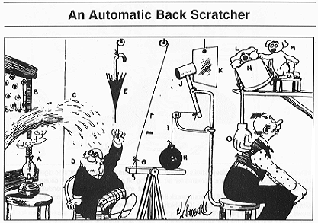
v1.0: KISS
Flame from lamp (A) catches on curtain (B) and fire department sends stream of water (C) through window. Dwarf (D) thinks it is raining and reaches for umbrella (E), pulling string (F) and lifting end of platform (G). Iron ball (H) falls and pulls string (I), causing hammer (J) to hit plate of glass (K). Crashof glass wakes up pup (L) and mother dog (M) rocks him to sleep in cradle (N), causing attached wooden hand (O) to move up and down along your back.

Slide 14
If you know the enemy and know yourself you need not fear the results of a hundred battles
Sun Tzu

Slide 15


Slide 16
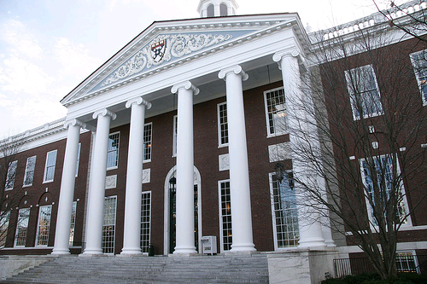
Some Case Studies

Slide 17

CATALYZING GREEN CHEMISTRY
Commercializing innovative chemistries which use
low cost renewable feedstocks to produce high-performance polymers and value-added chemicals
Notes:
May want to move investor logos to next slie and put in some kind of graphic around the value chain…
17

Slide 18
Technology Overview - core competency in catalysis
Renewable Feedstocks
Green
Materials
Carbon dioxide
CO₂
NOVOMER
High Performance Polymers/Plastics
Epoxide
(derived from
chemistry or
biology)
CATALYST
+
Carbon monoxide
CO
NOVOMER
Value-added
Chemicals
CATALYST
Uses existing chemical industry manufacturing facilities
Final material is comprised of up to 50% CO₂ or CO (by weight)
Notes:
Like the idea, colors / graphics need upgrade, could be a build slide, also should introduce LCA and cost impact of feedstocks and why they matter…

Slide 19
Broad Product & Application Opportunities
CO₂ based polymers
Aliphatic polycarbonates (APC)
Value-added Chemicals
CO based
>100,000 MW Molecular Weight < 1,000 MW
Packaging Coatings Surfactants
Small Molecule
Chemical Intermediates
Notes:
Verbiage will be key in these slide transitions…can discuss

Slide 20
NOVOMER CO₂ based polymers/plastics provide a unique
combination of Sustainability, Performance and Cost benefits
Sustainable Chemistry
Bio-based polymers
(PLA, PHA)
NOVOMER
Performance
Cost
Traditional polymers
Notes:
I might move this up a bit and instead of narrowing to the centroid, perhaps show something the visualizes the previous tradeoffs required between the 3 and that we can solve all…

Slide 21
Unique Value Proposition
Innovative “Green” Chemistries use pollution as sustainable feedstock:
Carbon dioxide
Carbon monoxide
Low Cost/Competitive Cost Positions:
Cheap feedstock (CO₂ & CO)
Less costly reaction conditions
Lower capital requirements – manufacturing processes use
existing chemical industry production facilities
Superior Material Performance – polymers:
Precise internal molecular architecture
Precise control over finished product molecular weight distribution
Biodegradable
Tunable performance to meet specific market needs
Platform Technologies with multiple product opportunities
across multiple markets
Notes:
This builds on previous, not sure if possible to do in one well done graphical slide. Need some graphs to support cost assertions and put thi smor ein terms of curent industry problems around performance, cost and LCA. Might be a good time to introdcue the 3 intersecting circle idea from later that the industry needs something at intersection of sustainable, performance and cost and that previously you oculd pick 1 or 2 but not all three…

Slide 22
Business Model: Commercial Partnership Structure
Initial Product/Process development stage
Identify most attractive product opportunities for specific materials
Validate process and material economics
Formalize Commercialization Agreement:
Technology access fee
Potential economic structures:
Catalyst supply: Novomer makes and sells catalyst
Royalties based on sales/Profit split
Partner manufactures /Novomer scales-up through toll manufacturer
Sell through Partner’s customer facing organization
Notes:
Seems we need to lost target partner names and line up against platform graphic

Slide 23
Business Model: Multiple Commercial Partnerships
Packaging
Single or multiple parties
Potential for 3 party deal (s):
Consumer Product Company/Resin manufacturer/Novomer
Coatings
Single or multiple parties
Surfactants – EOR
Single or multiple parties
Potential for DOE support/grants
Value-added Chemicals
Multiple parties based on molecule
Acrylic acid
Succinic anhydride
Notes:
Would prefer a graphical flow…

Slide 24
Energy and Resource Recovery

Slide 25
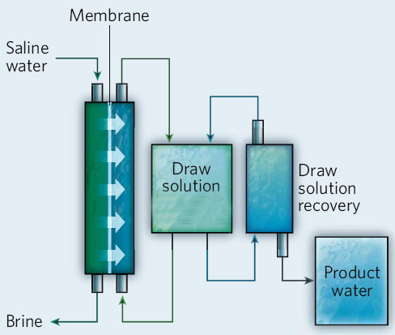
Engineered Osmosis (EOTM) How it works
Water is separated from the feed stream by a natural osmotic pressure – EO™ is an unpressurized desalination process
The “draw” solution is designed to have a high osmotic pressure, but be easily removed through simple heating, producing potable water of high quality (same quality as RO)
The membrane is nearly identical to that used in RO today and does not require specialized manufacturing
EOTM can be integrated into power generation facilities without any reduction in performance or modifications to existing infrastructure, such as cooling towers and condensers
Oasys Water Treatment Process
low quality “reject” heat
(temp 40-150⁰ C)
Notes:
25

Slide 26
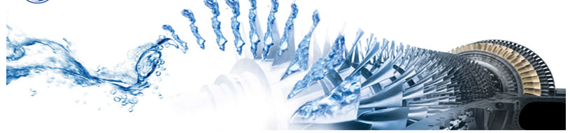
Oasys Osmotic Application Systems
Engineered OsmosisTM (EOTM) is a new platform for recovering low quality heat to produce valuable energy resources; potable water, process water, electric power and energy storage
Overview
EOTM utilizes low grade heat to generate high hydraulic pressures – “osmotic pressure”
Eliminates the need for large amounts of electricity for treating and desalinating water
Recovery of wasted energy / immediate increase in energy utilization and efficiency
Lowest cost structure available for producing potable water from a variety of non-potable sources
Oasys products
Reuse – single stage wastewater reuse to process water and indirect potable reuse
Desalination – Ultra low cost seawater desalination
Energy – power generation and utility-scale osmotic hydro-electric storage
Commercialization
Pilot plant nearing completion - now being scaled to commercial demonstration product
100-500 m³/day integrated skids for customer testing ready Q3 ’10
Company is seeking industrial and strategic partners for commercialization and scale-up

Slide 27
Water Markets
Oasys is targeting three core markets
Desalination - $10B
Wastewater - $100B
Power Generation and Grid Storage - $1T
Initial market entry points
Desalination – concentrating brine to existing increase plant capacity
Wastewater – Recovering industrial wastewater for reuse
Power/Storage – heat recovery osmotic storage device (DOE funded)
Company is focused on markets with low barriers to entry
High demand for better water utilization
High demand for a disruptive approach, risk tolerance
Industrial customers, not municipalities
Small scale, “bolt-on” products, with reduced scope and ease of integration
Limited competition exploiting unique capabilities of EOTM

Slide 28
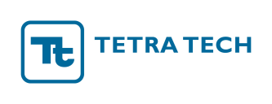
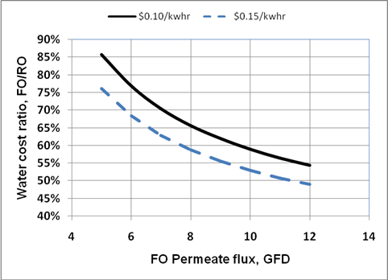
Cost Advantage Membrane performance improvements – 50MGD
2008 membrane performance: 0.5-1 gfd initial approx.
June 2009 membrane performance: ~2 gfd initial approx.
Sept 2009 performance: 4.5 gfd approx. initial flux
Dec ’09 performance: 6. gfd average true flux
Dec ’09 performance: 6. gfd initial true flux
Yale: 12-14 gfd initial approx. flux, (hand crafted membrane)

Slide 29
Cost Advantage EOTM represents the lowest possible water treatment cost structure in the industry
Technology | Total Water Cost ($/m³) 10 c/kWh
RO | 0.68 - 1.19
MED (thermal) OASYS EO™ | >1.00 <0.27 - 0.50
EO™ cost reduction | 50-65%
This number will be significantly higher in markets where electricity is expensive
MED is energy inefficient, requires parasitic steam
Most energy efficient process available
Recently completed detailed side by side cost estimate by TetraTech¹
Cost differential:
1/10 the electrical energy of RO separation
Capital savings of 20-30% over RO
>60% reduction in operating costs over RO
Significantly more thermally efficient than MED, at much lower temperature
EOTM cost advantage grows with increase in cost of electricity prices
¹June 2007, Engineering News-Record magazine named Tetra Tech the nation’s number one firm in Water Treatment/Desalination. Tetra Tech’s engineering services for water reclamation and water supply, including desalination, are world-class: www.tetratech.com

Slide 30
Oasys Market Entry Point Evaluation indicates that seawater brine recovery is best product entry point
RO bolt-on for brine recovery is an ideal entry point:
Company remains focused on core capability and largest market opp
Seawater desal is the best application of the technology
Gen I membrane is capable of treating brine at a 50% cost advantage
Bolt-on model limits risk to the customer – easy adoption
Market can be addressed at small scale initially
Company can use a “service” model to maximize profits / reduce customer impact / accelerate adoption
Value proposition is very clear – lowest cost expansion of existing facilities
Oasys plant can fall “within the fence” – no new permits required
Lux has validated the availability of waste heat within existing RO plants
Product can be introduced early to drive revenues prior to greenfield execution
Profitable small installations can be leveraged to move to larger scale
Drives home the company’s mission of “Energy and Resource Recovery”

Slide 31
A Few Take Aways…
You are not the target demographic
Know your target audience, ask them, then listen
Don’t over-engineer, better to over market
What is your engineering to market research spend ratio?
Fail early, fail often, fail cheaply – then succeed!
Get into the market as soon as possible
Version thoughtfully, and regularly
Share product roadmaps with your customers (carefully)
It’s not (only) about product features…
Don’t forget the “other” 3Ps
Know the competition as well as yourself
Sun Szu rocks

